Slide 1
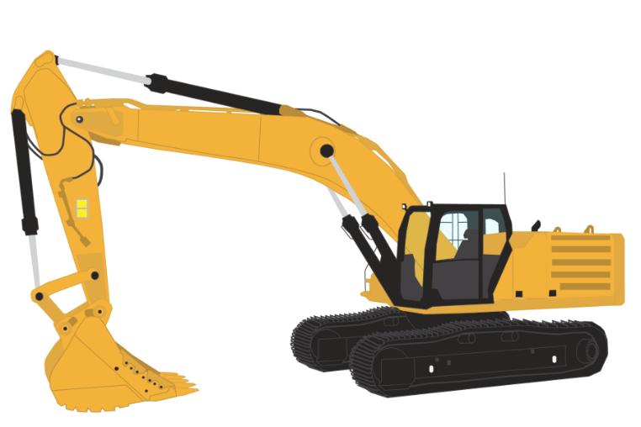

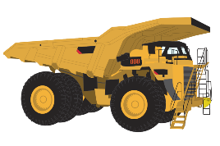
Project 3
US injury dashboard and Machine learning injury predictor
By Grant Towers and Nicholas Mcmahon

Slide 2

Contents
Data Preparation
Database/Hosting
Data Migration
Data Visualizations
Machine Learning
Flask App
HTML Page

Slide 3
Data Preparation

Slide 4
Database/Hosting

Slide 5
Data Migration

Slide 6
Data Visualizations

Slide 7
Machine Learning

Slide 8
Flask App

Slide 9
HTML Page

Slide 10
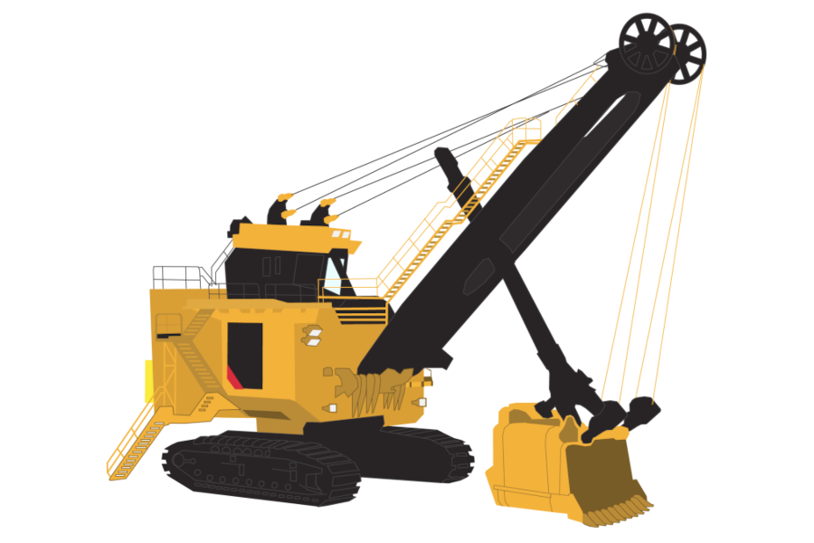

Thankyou for listening
Stay safe out there!

